Slide 1
Monetize AI
Pujitha
Pradeepika Kolluru(16283597)
Sravan Kumar pagadala(1628077)
Thoshita movva(16279838)

Slide 2
Goals
Understand IBM cloud
Learn and use machine learning algorithm for classification
Code together and exchange ideas and experiencses

Slide 3
Technologies used
Python
Jupyter notebook
Github

Slide 4
Data set
We worked with the Cancer dataset, which contains 569 samples of malignent and benign tumor cells. The first two columns in the data set store unique ID numbers of the samples and the corresponding real-value features that have been computed from digitized images of the cell nuclei, which can be used to build a model to predict whether a tumor is benign or malignant.

Slide 5
Hackathon tasks
Interacting with Python libraries through API
Plotting
Data loading and Visualization
Correlations ( two types of regression : Linear, Logistic)
Data encoding
Data Preparation

Slide 6
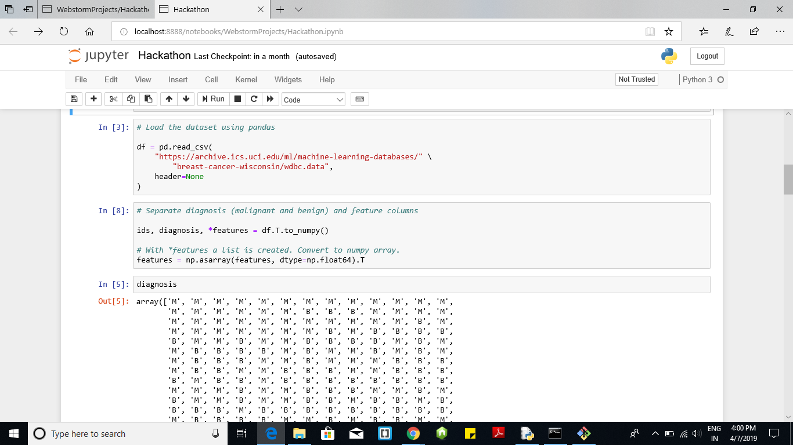
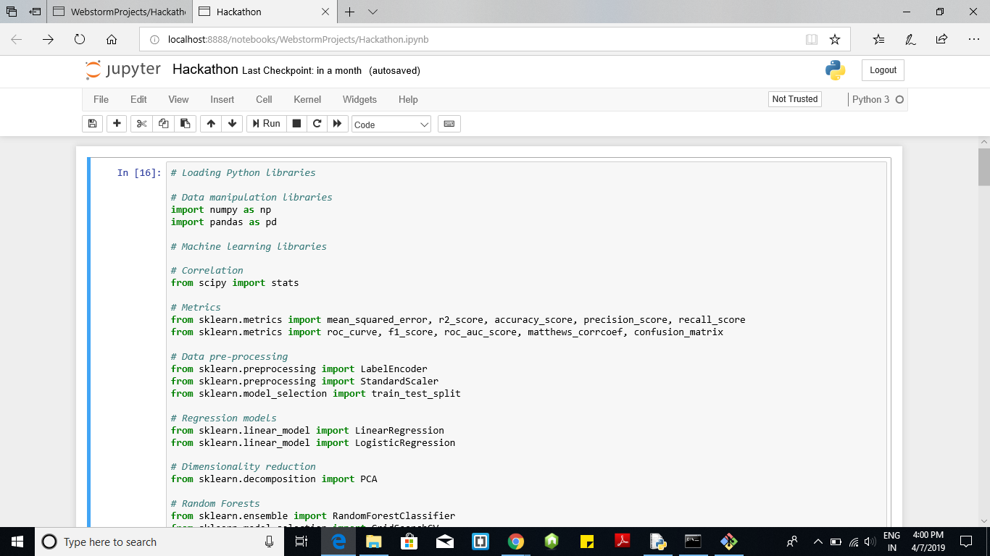
Screenshots

Slide 7
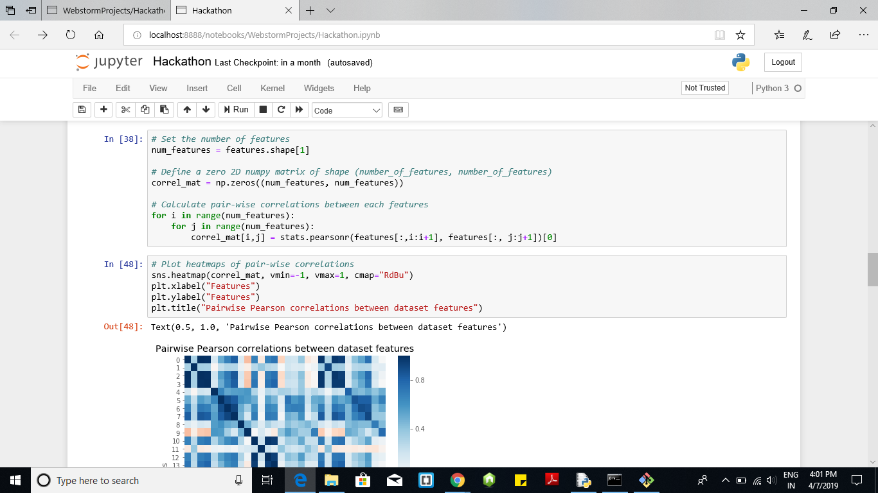
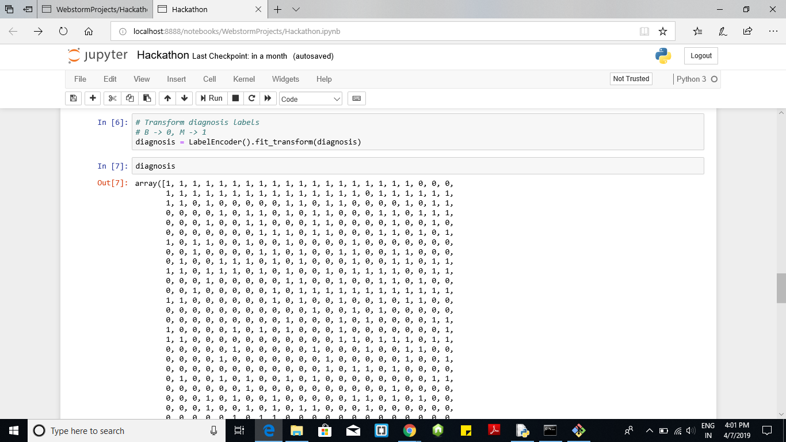

Slide 8
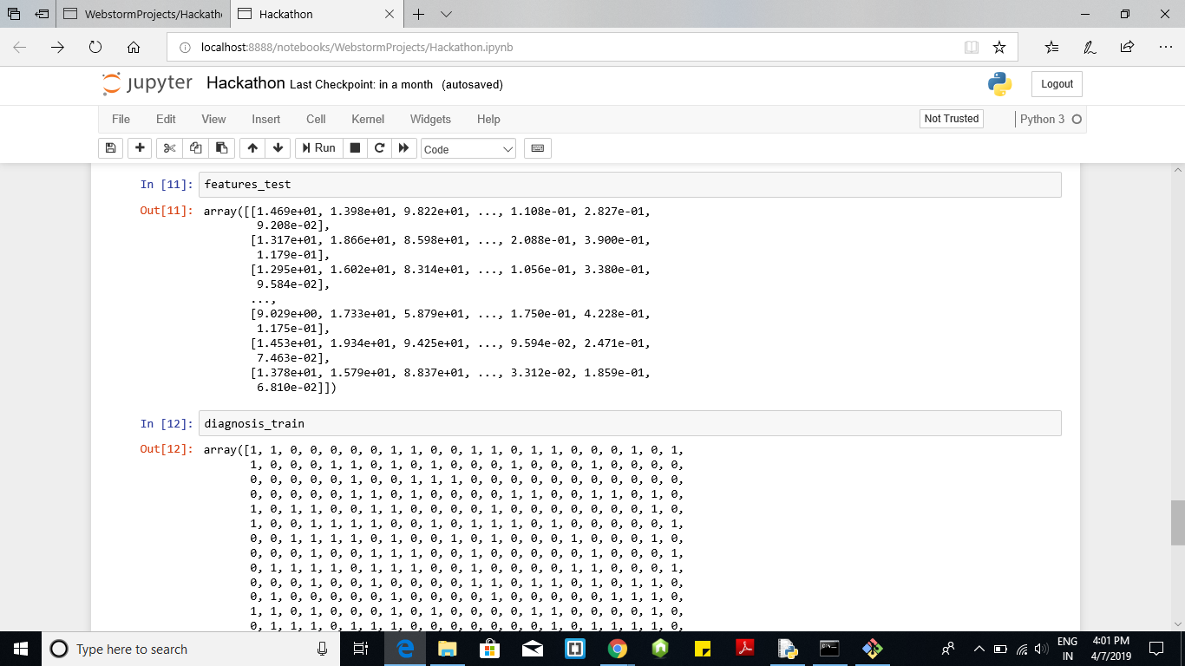
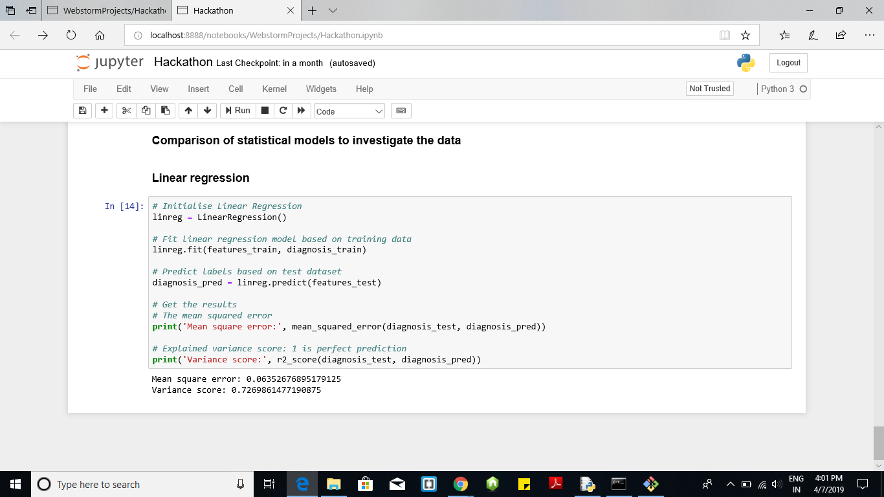

Slide 9
Thank you

